Slide 1
Project#8
Freemium A/B Testing
Scope: This project’s scope is to help a B2B (business-to-business) SaaS (software-as-a-service) company analyze its recent A/B test for its explainer video. The company uses these videos to convince free users to start a premium trial.

Slide 2
Team members:
Nadir Syed – Lead Developer, sql, python. Exp 14 years.
Shahid Kizilbash – DBA/Data Engineer. Exp 14 years.
Kusay Rukieh – Data Analyst, Network engineer. Exp 20+ yrs
Rafiat Bello – Masters(Biology), pursuing applied science
Sajid Kharoundwala – BI & Data Analyst
Communication channels:
Whatsapp for notifications, meetup invites etc & Slack for knowledge & document sharing. Skype for meetings and screen share.

Slide 3
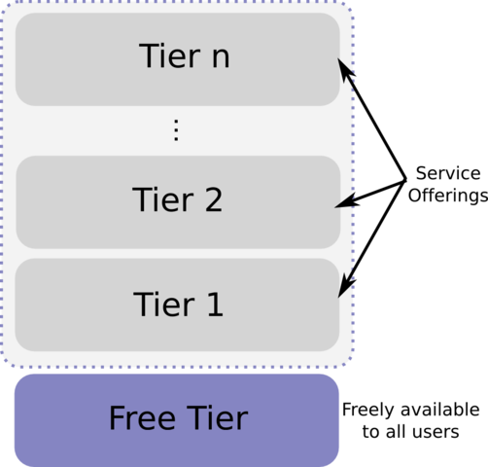
Background:
The term "freemium" refers to a service with two tiers:
Free tier that has only basic capabilities
Premium tier(s) that has the full set of features
“AB testing” is essentially an experiment where two or more variants of a page are shown to users at random, and statistical analysis is used to determine which variation performs better for a given conversion goal.

Slide 4
Challenges:
For B2B software, it can be trickier to convince free users to upgrade to premium plans due to a variety of reasons. Two of the most common are
Users may first need approval from a manager or budgeting department.
Users might not understand what the premium plan offers, especially if it introduces new services and features.
Freemium acquisition model helps with 2nd and reduce the cost required to acquire new customers by shifting the education burden from sales/marketing to the customer.
Recommended read:
https://blog.hubspot.com/service/freemium
https://www.optimizely.com/optimization-glossary/ab-testing/

Slide 5
Objectives:
Determine which sources/devices/industries had the highest conversion rates.
Build a model that can predict conversion rate based on user data.
For high conversion rate users, what are the implications for the company's marketing team?
For low conversion rate users, what are the implications for the company's customer success teams?
Provide actionable insights to the business. What have we learned from this test?

Slide 6
Questions:
Define conversion rate?
Example: % users signup & convert in a day/week?
Quantify Conversion rate range?
Example: High: 25-30%, Low: 1- 5 %
Elaborate business problem? Analyze conversion rate of old explainer video & predict conversion rate of new video?
Use only old explainer video data or only new explainer video data or both?

Slide 7
Questions continued…
Kusay
1. Browser type is used for the transaction? 2. authority of the person who is trialing? 3. What device is used for trial period? 4. The channel which is used to get the software? 5. The date in which the user watch the tutorial video
Shahid
Is the company relying on source to create the explainer videos?
Can the videos be customized to properly convince free tier users?
What were the main differences between the old video and the new one?
What is the selection criteria for the control and test group?
Is the duration of membership important?
Rafiat
What device did the user use to view the video?
What percentage of current user sign up on mobile device after viewing the video?
What is percentage of signup with the old explainer video?
Is the old and new video all browser friendly?
Is there a particular browser with more signup?

Slide 8
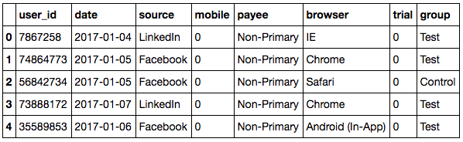
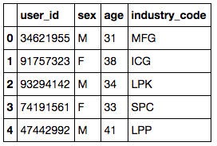
Data:
ab_trial_results
Control – Old Video Test – New Video
user_industry

Slide 9
Data Dictionary:
user_id - Unique ID for user
date - Date the user watched explainer video
source - Marketing channel user came from
mobile - Was user on a mobile device?
payee - Whether the user is the primary decision-maker for budgeting
browser - The user's browser
trial - Did the user convert, i.e. start a premium trial?
group - Group (test / control)

